Slide 1

Python Scripting with Network
Day 12

Slide 2

Agenda
Network Automation with Python Files
Essential File types for Network Automation
Production Best Practices
Log collection and parsing
Report Generation

Slide 3
Network Automation with Python
To build an automation workflow, you typically organize your project across four categories of files: Scripts to run logic, Inventories to map devices, Templates to generate standard configurations, and Outputs to store gathered metrics.
Opening the File: Use the open() function to open a file. In this example, ‘show_version.txt’ is the file you want to read. If the file is in the same directory as your Python script, just provide the filename. The open function returns a file object, which we assign to the variable f.
Reading the File: After opening the file, use the read() method to get its contents. Here, we read the entire file as a string and store it in the data variable.
Closing the File: It’s important to close the file after reading it using the close() method. Not closing the file can cause resource leaks and other issues. Although Python can automatically close the file when the script ends, it’s best practice to close it explicitly.

Slide 4
Essential File Types with Python
.py (Python Scripts): Houses the main execution logic, handling SSH connections, executing API requests, and managing errors.
.yaml or .json (Inventory Files): Stores structured infrastructure details such as host IP addresses, device operating systems, usernames, and connection ports.
.j2 (Jinja2 Templates): Skeleton configuration blueprints. Python maps variable data from your inventory into these files to generate raw configurations dynamically.
.csv or .txt (Output Files): Captured diagnostic data, automated config backups, or inventory audits extracted from multiple live devices

Slide 5
Network Automation Production Practices
Secure Credentials: Never hardcode passwords directly into scripts or raw text inventories. Use environment variables via os.environ or call secure vaults.
Implement Safe Parsing: Raw CLI terminal readouts can be messy. Utilize tools like TextFSM to structure plain-text terminal data directly into predictable Python dictionaries or lists.
Track File Changes: Always initialize a Git repository around your script, template, and inventory directories to track modifications, roll back errors, and safely collaborate.

Slide 6
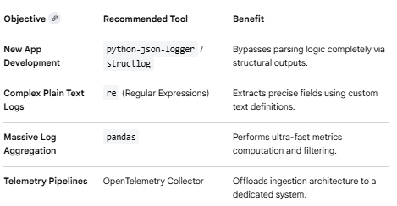
Python Log Collection and Parsing
Python provides built-in modules and third-party libraries to handle the entire log collection and parsing pipeline efficiently. This guide covers how to generate/collect logs cleanly and how to extract structured data from unstructured text.
When dealing with traditional, legacy plain-text log files (like Apache, Nginx, or syslog), you can choose your strategy based on complexity.

Slide 7
Report Generation
The best Python report generation library depends entirely on your preferred output format (PDF, HTML, or Excel) and whether you want to write code from scratch, use HTML templates, or auto-generate automated data analysis summaries.
A versatile tool specifically built to construct standalone, shareable HTML reports containing interactive components. It supports rich layout configurations, code snippet formatting, text callout blocks, and natively integrates with Plotly Express interactive charts.
python -m pip install report_creator -U

Slide 8
Wrap Up
Python Automation for Network engineering
Python Network Libraries
Python logging data parsing
Python Reporting

